Slide 1


Generative Models Part 1
Ferdinand.bhavsar@minesparis.psl.eu
1
Notes:
Objectif : Explorer le potentiel des méthodes de gen. Profondes pour remplacer quand la quantité de données le justifie, les méthodes classiques de modélisation
1

Slide 2
Introduction
2
Notes:
Objectif : Explorer le potentiel des méthodes de gen. Profondes pour remplacer quand la quantité de données le justifie, les méthodes classiques de modélisation
2

Slide 3
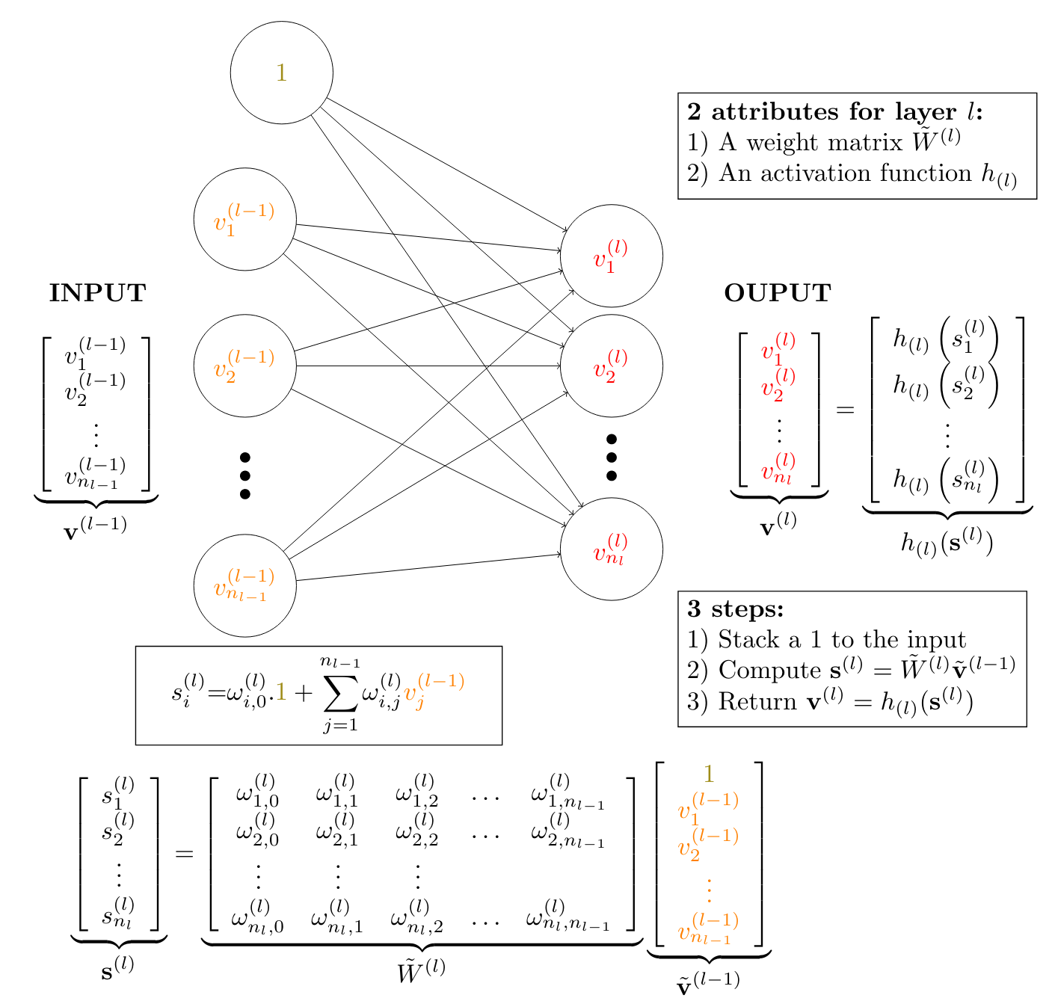
Deep Learning : We need to go deeper
3

Slide 4
Unsupervised Learning
4

Slide 5
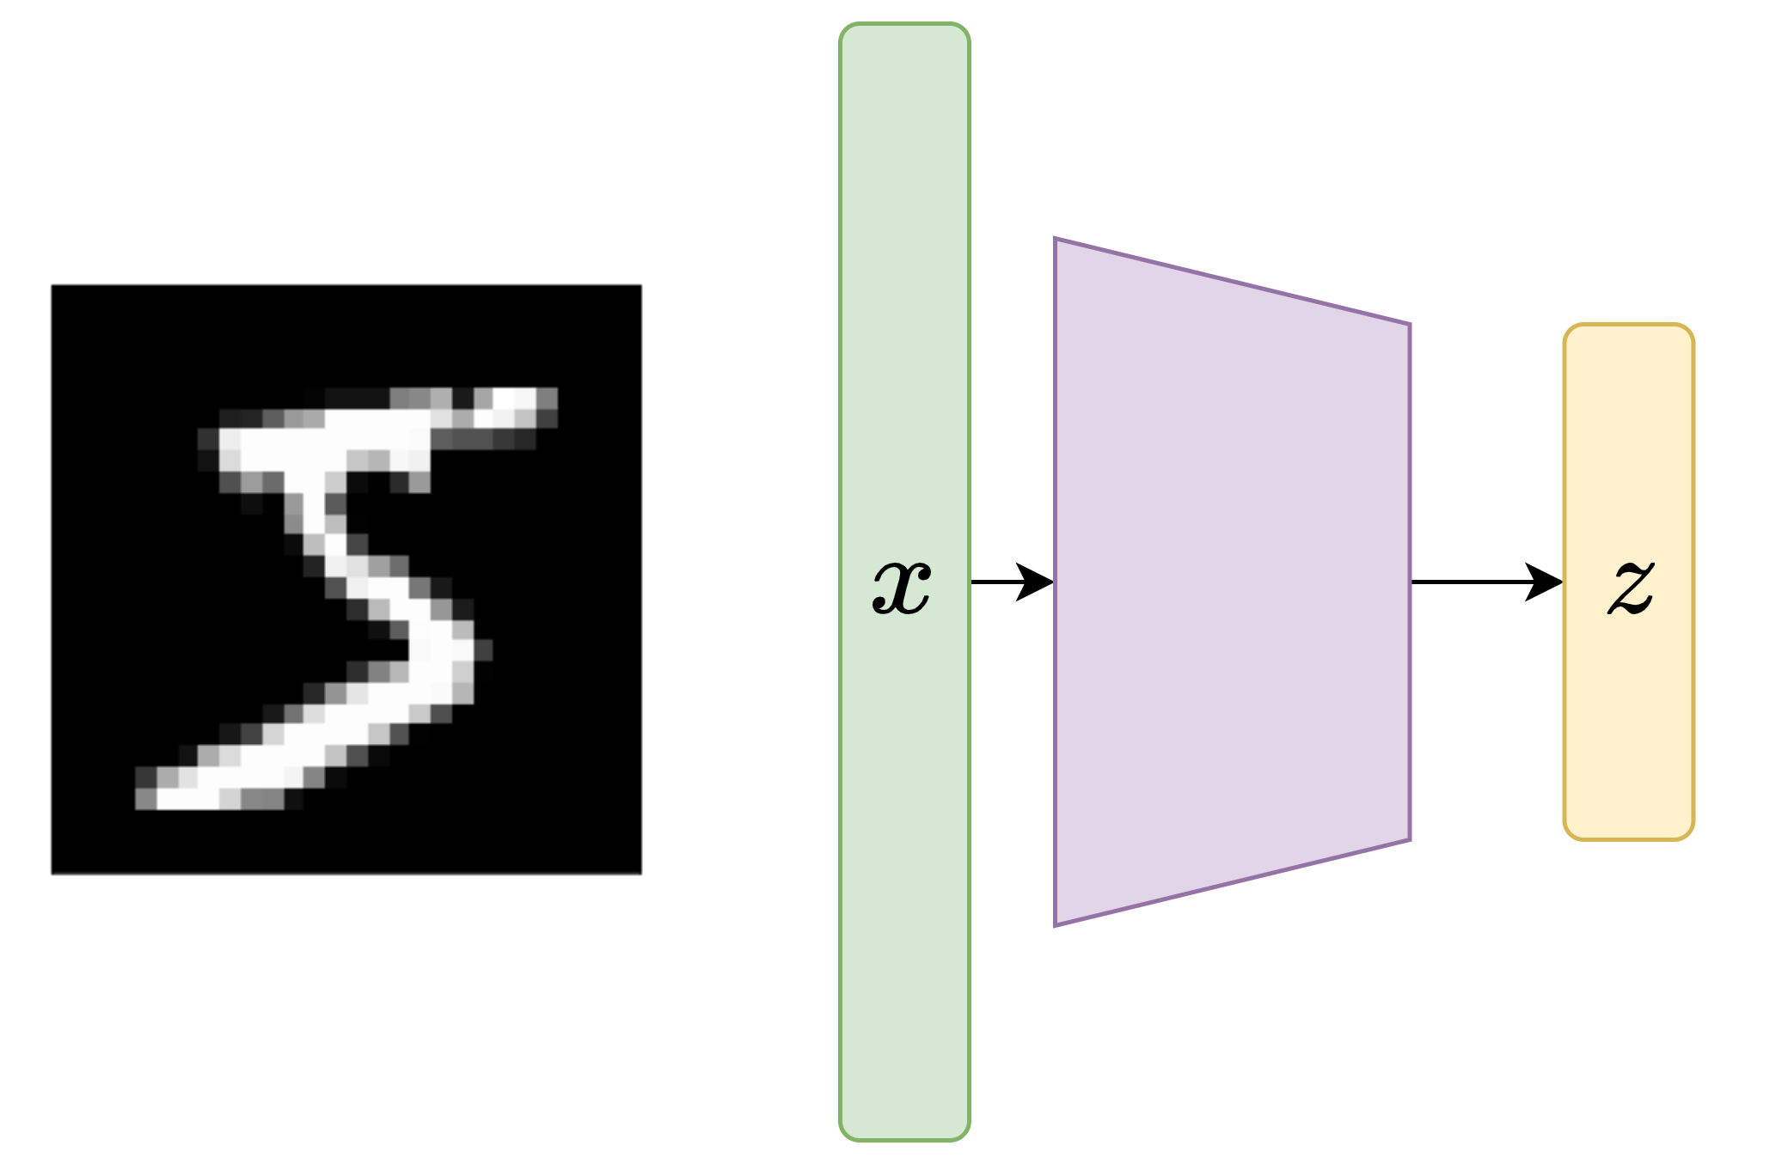
Dimensionality Reduction : We few, we happy few...
Using a neural network, we can learn a low-dimensional encoding representation from unlabelled training data (unsupervised learning)
This network is the encoder and learns a mapping from the data-space to a latent-space.
➔ It can be seen as a non-linear version of the PCA
5

Slide 6
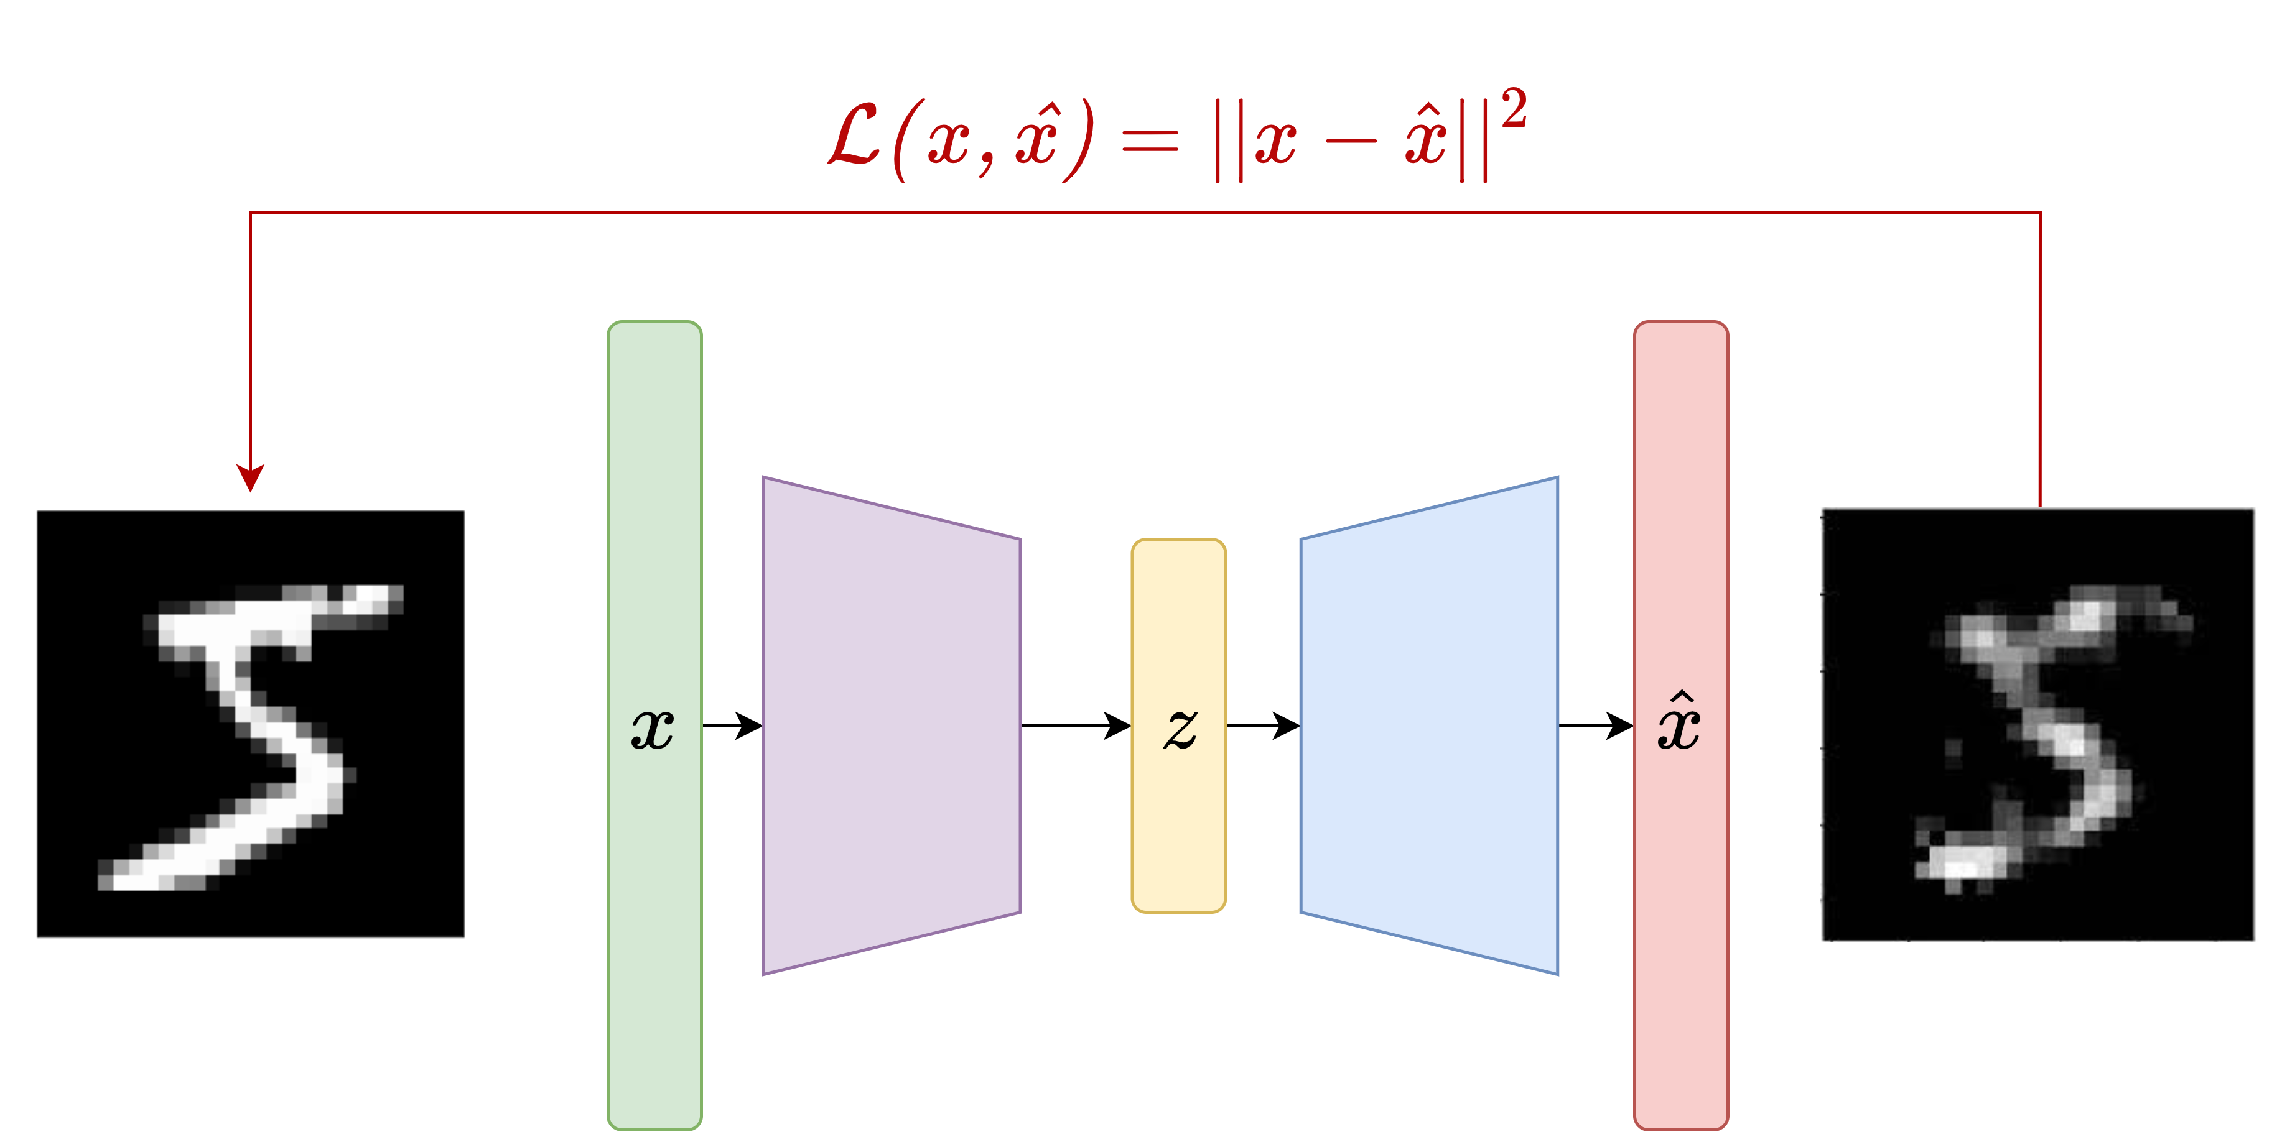
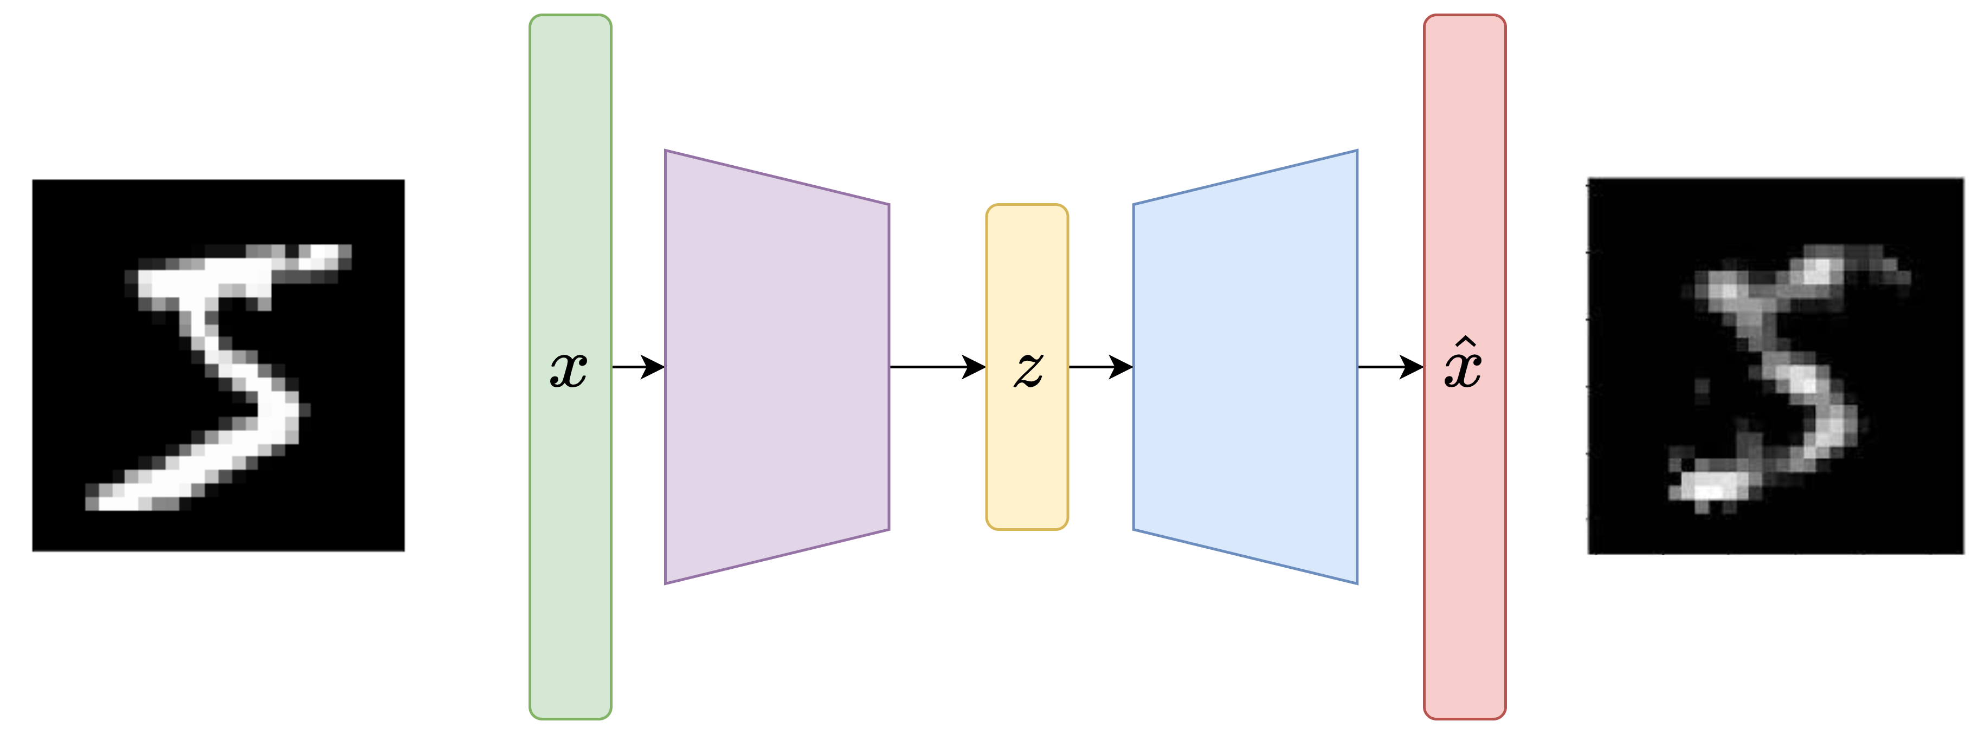
Dimensionality Reduction: Auto-Encoders
How to train the encoder to learn this mapping ? By training another model to use the encoding to reconstruct the original data
6

Slide 7
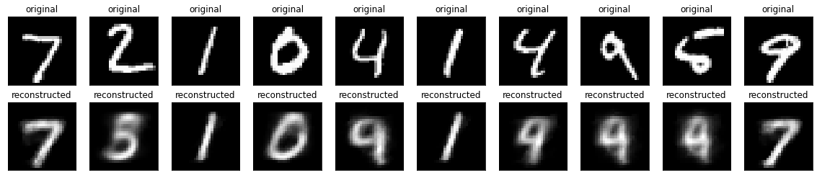
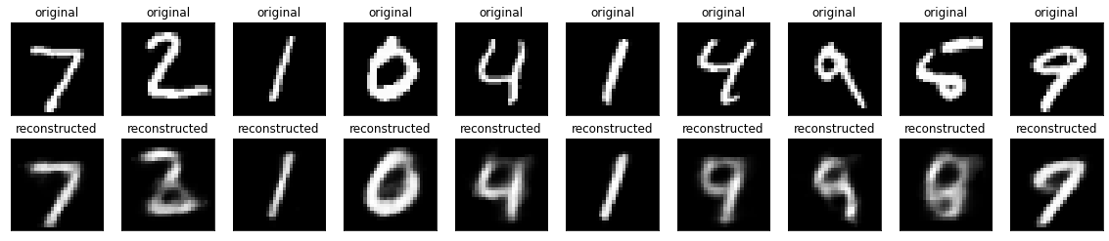
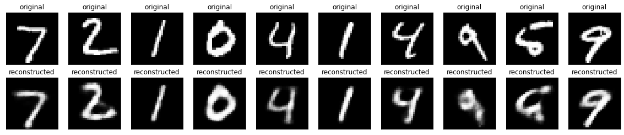
Auto-Encoders: Latent Size
Original
Latent size = 2
Latent size = 5
Latent size = 10
The bigger the latent space, the more high-dimensional features it captures
7

Slide 8
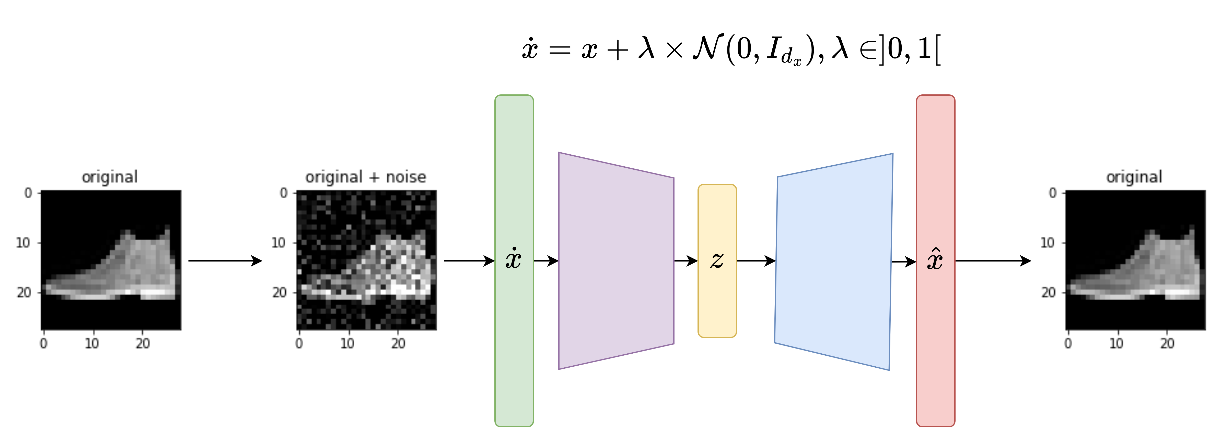
Application: Denoising AE
8

Slide 9
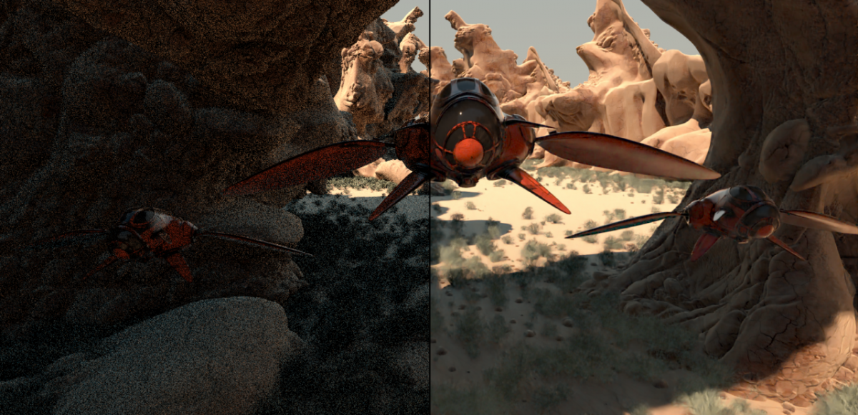
Denoising AE: It's useful !
Real Life usage: NVIDIA OptiX™ Ray Tracing Engine
9

Slide 10
Generative Learning Principles
10
Notes:
Objectif : Explorer le potentiel des méthodes de gen. Profondes pour remplacer quand la quantité de données le justifie, les méthodes classiques de modélisation
10

Slide 11
Deep Generative Models
Problem : Given a dataset, we want to sample never-seen before, convincing data with the same properties as the dataset
Deep Generative Models :
Easy to sample low-dimensional Random Variable (often a Multivariate Gaussian)
Complex and unknown Random Variable (our dataset distribution)
G
11

Slide 12
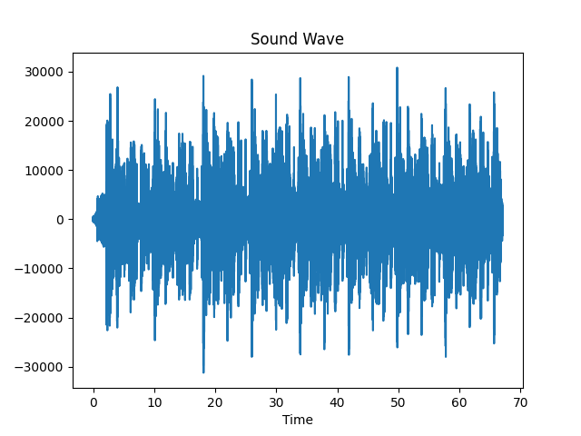
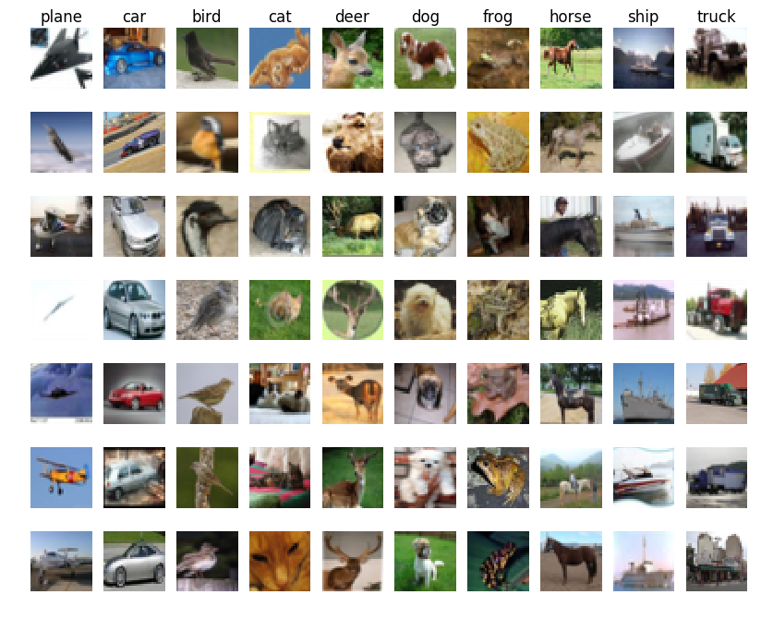
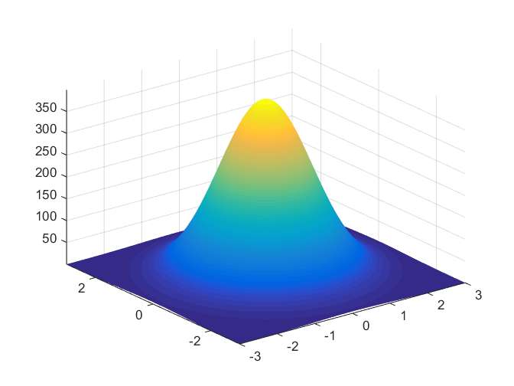
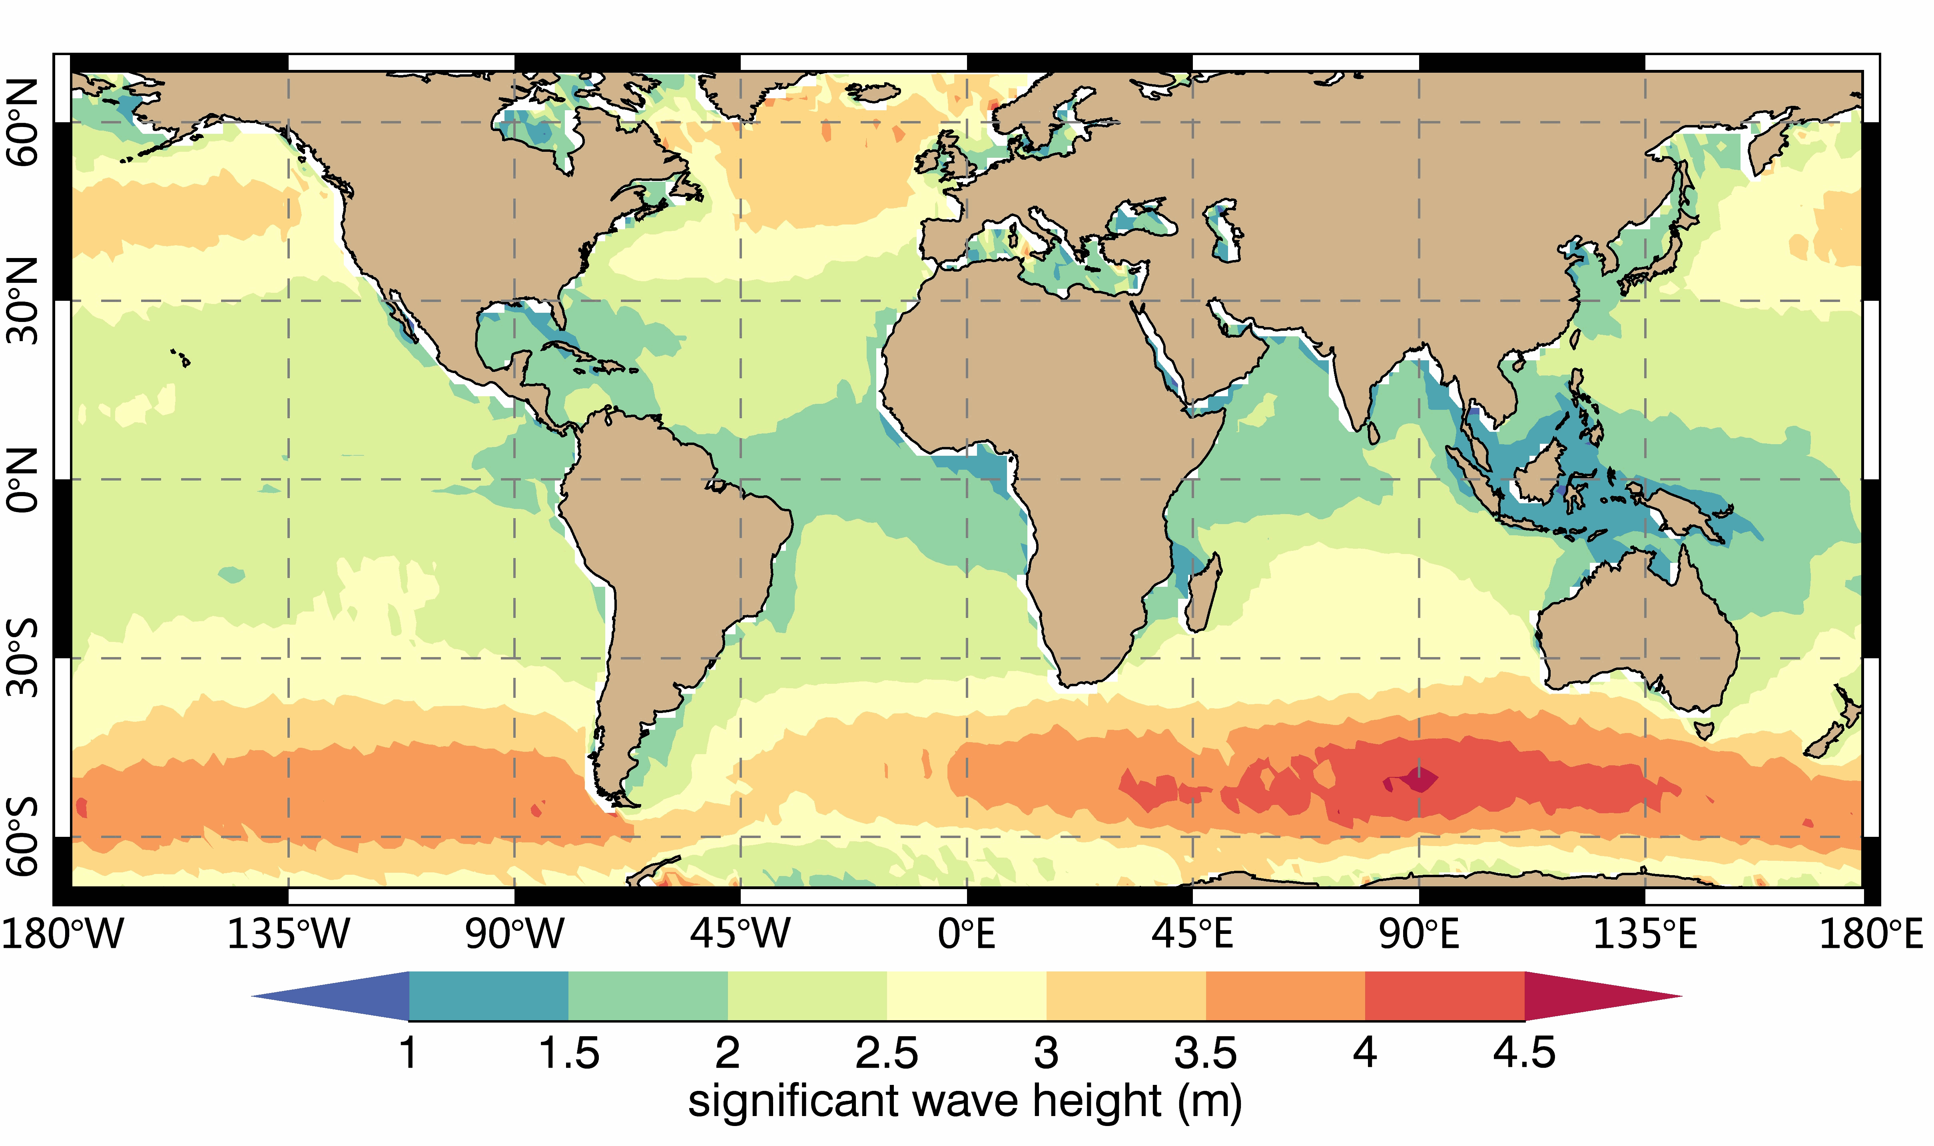
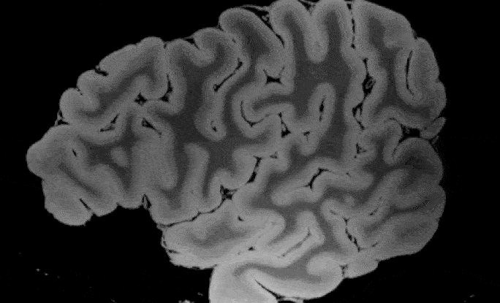
Deep Generative Models
Problem : Given a dataset, we want to sample never-seen before, convincing data with the same properties as the dataset
G
12

Slide 13
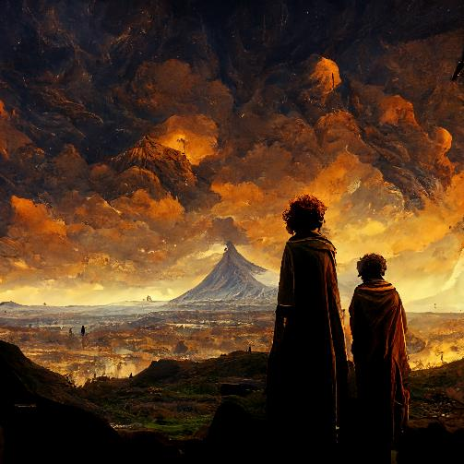
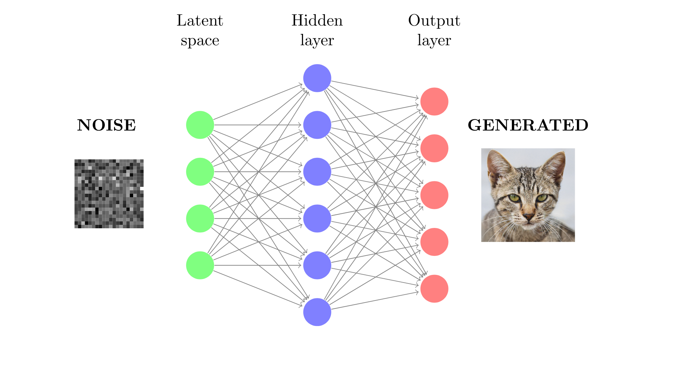
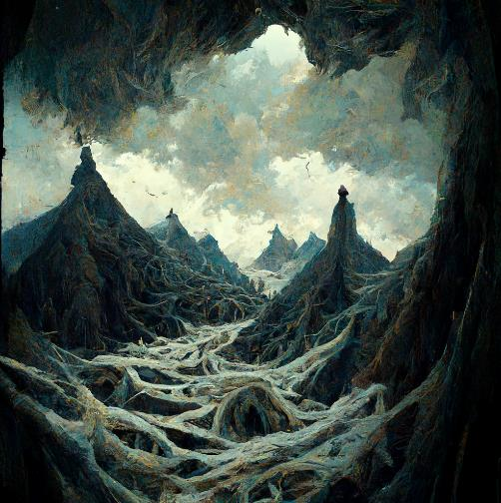
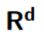
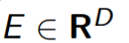
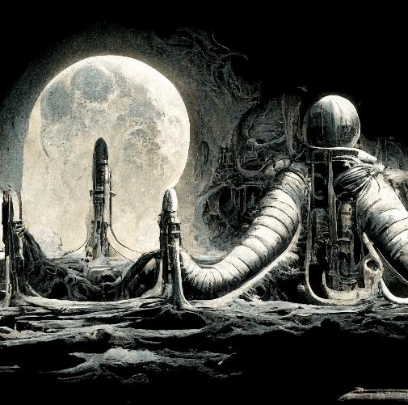
Prompt : "Frodo and Sam looking over Mordor"
Deep Generative Models: Generator
Prompt : "At the Mountains of Madness"
Prompt : "Apollo 11 in H.R. Giger style"
Generated art pictures from a prompt using a generative network
Source: https://www.midjourney.com/app/
Can be seen as a generalisation of Gaussian Simulations
13

Slide 14
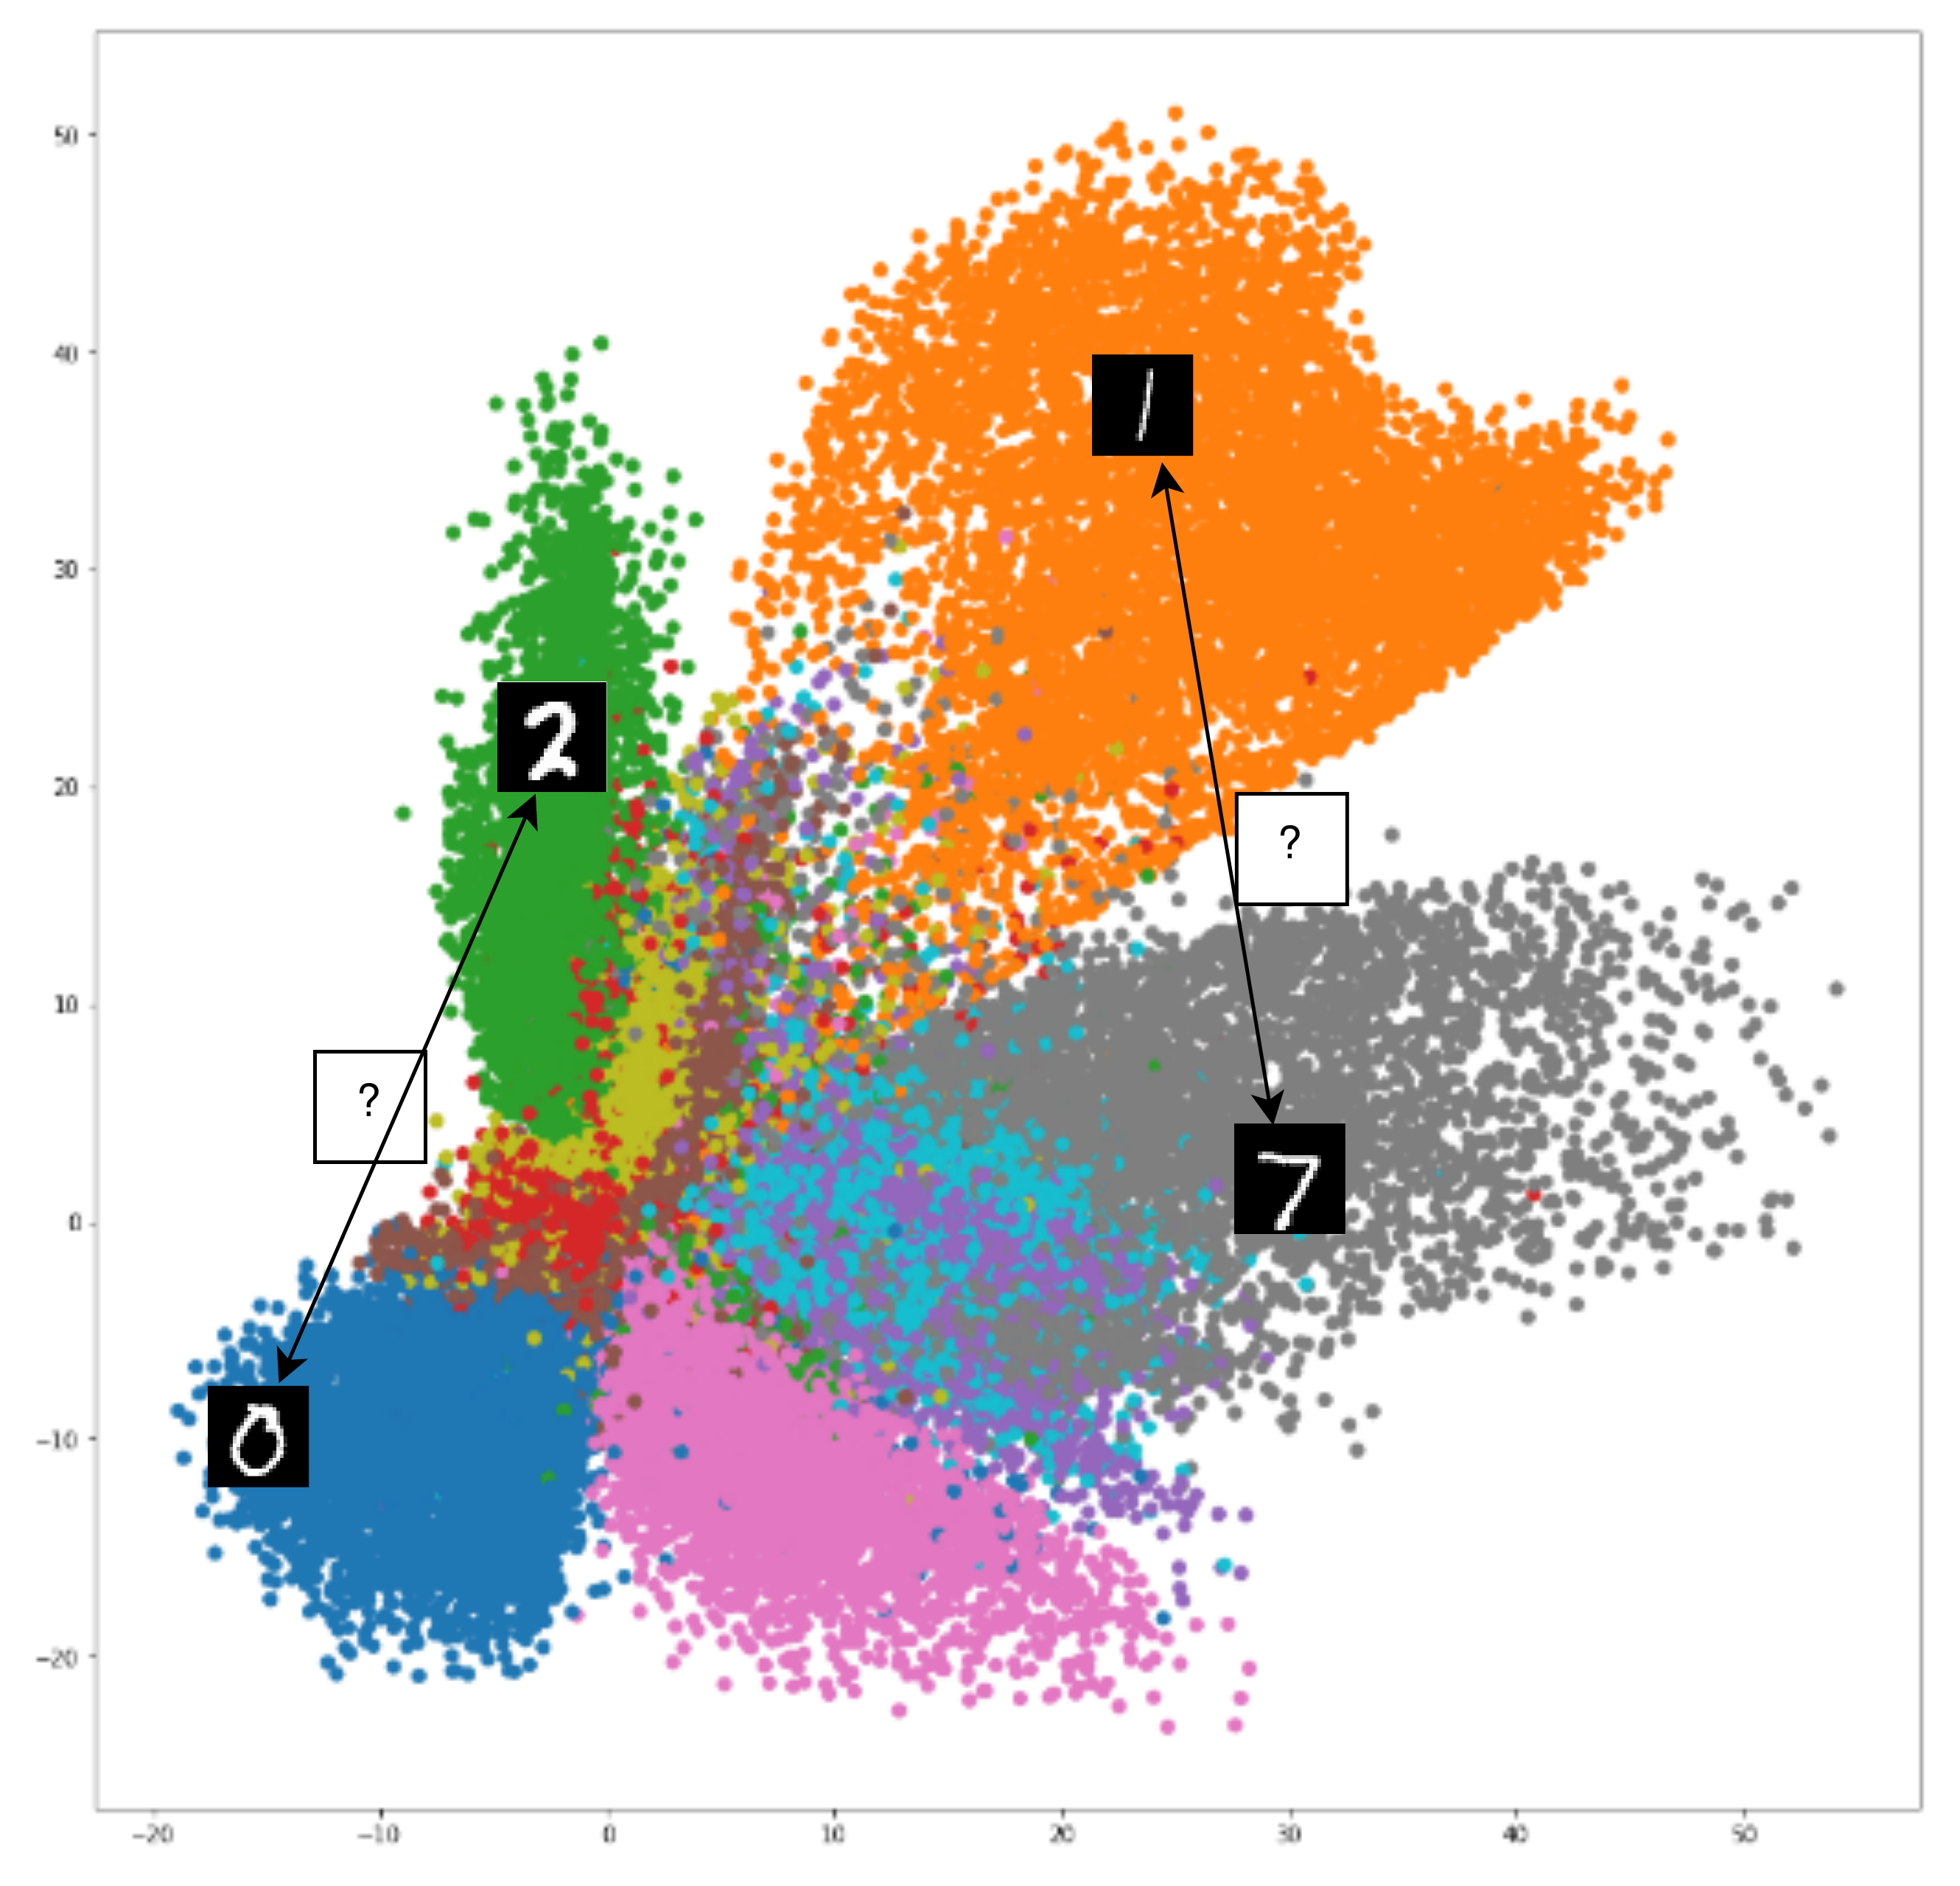
Something is rotten in the state of Auto-Encoders
AE are deterministic: they learn a mapping from images to a latent space, and from the latent space back to the images
The latent space isn't smooth and may not be continuous or easily interpolated --> not a distribution
Which means the model is not suited for Generation
14

Slide 15
Variational Auto-Encoders (VAE)
15
Notes:
Objectif : Explorer le potentiel des méthodes de gen. Profondes pour remplacer quand la quantité de données le justifie, les méthodes classiques de modélisation
15

Slide 16
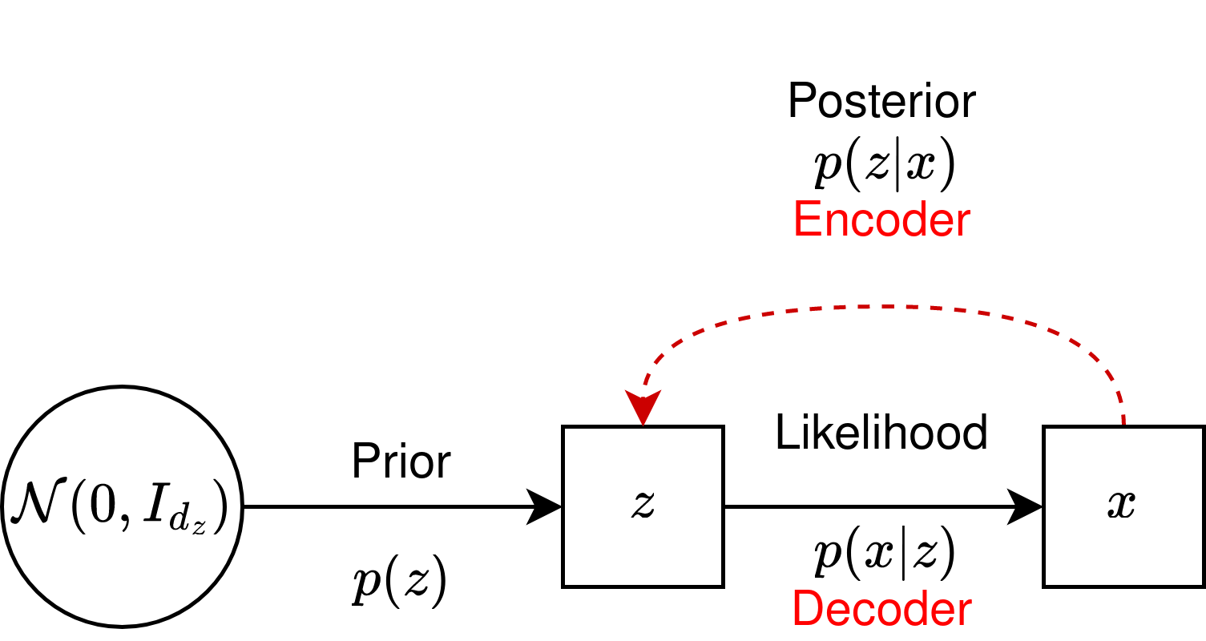
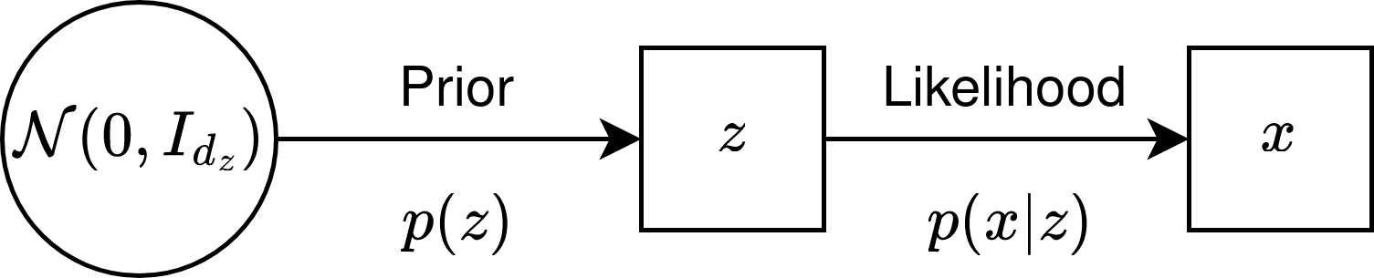
Variational Bayesian Learning
16

Slide 17
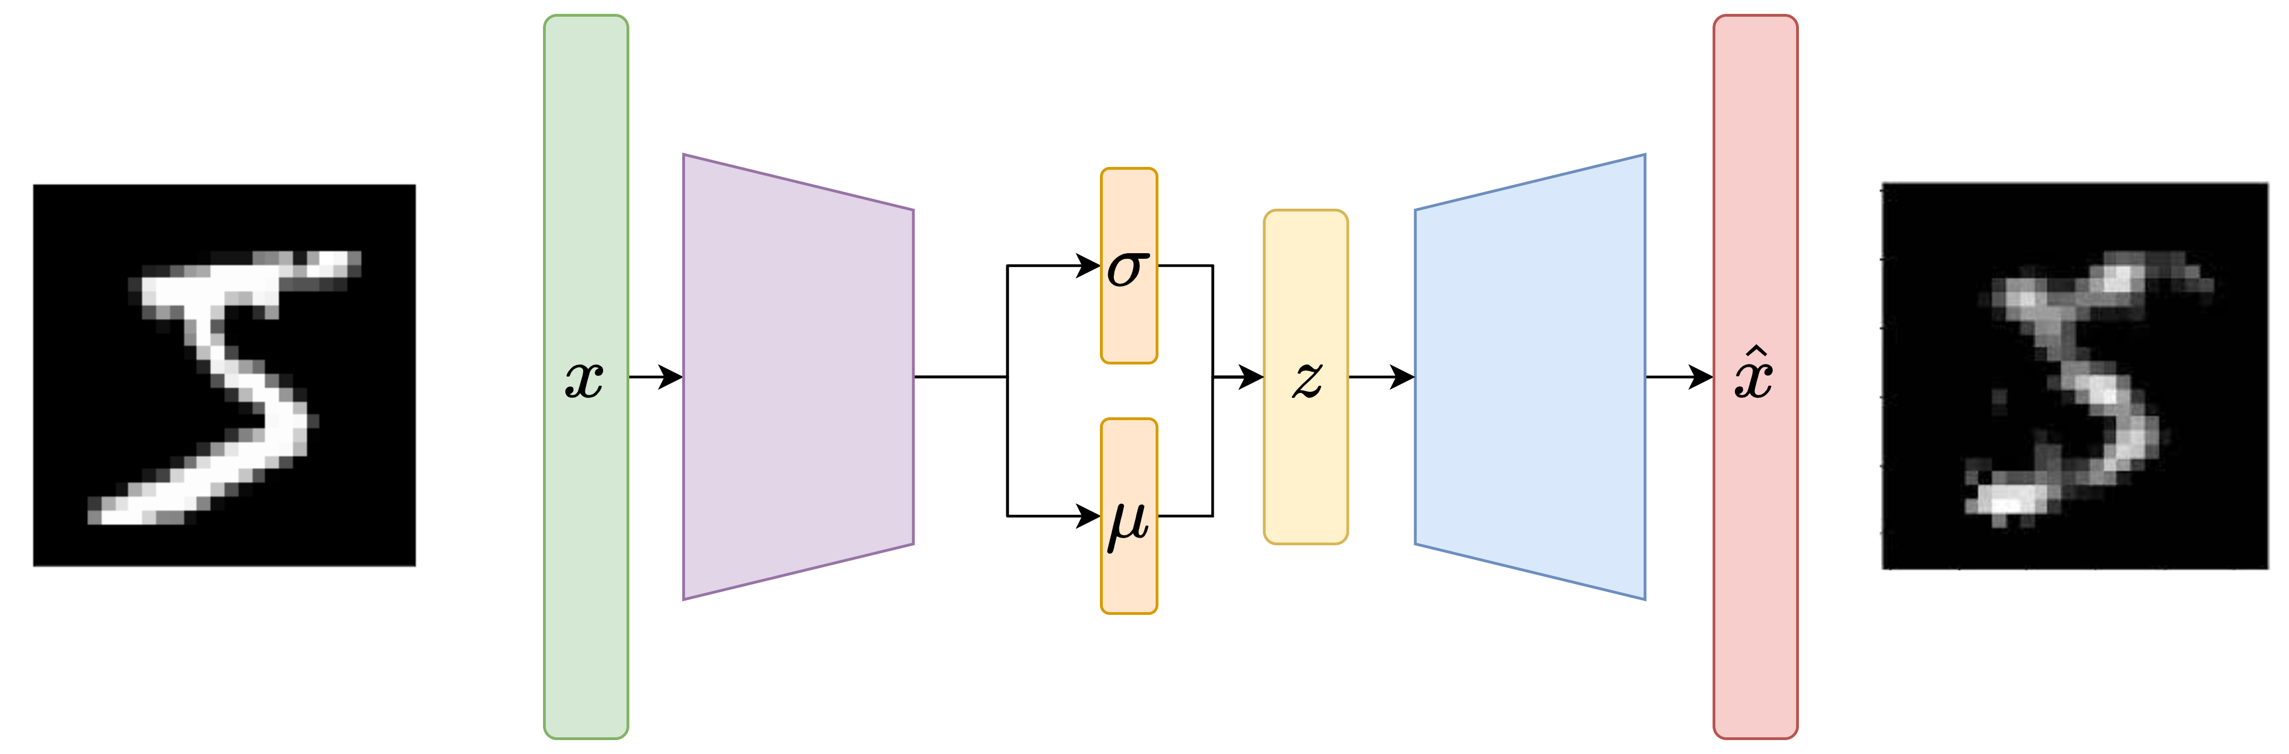
Variational Auto-Encoders
Bayesian Modelisation
17

Slide 18
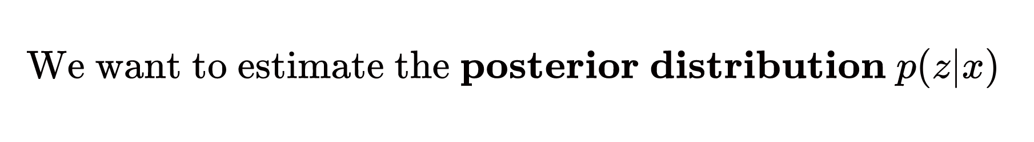
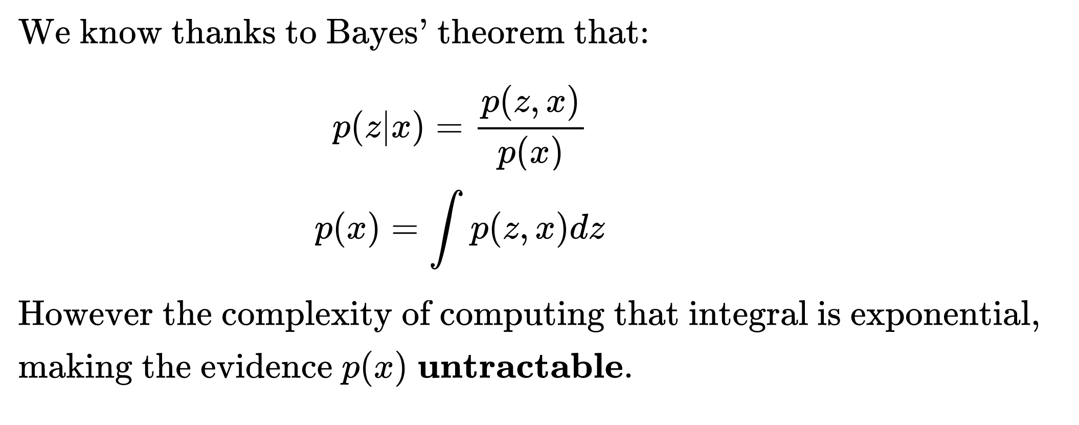
Variational Bayesian Learning
18

Slide 19
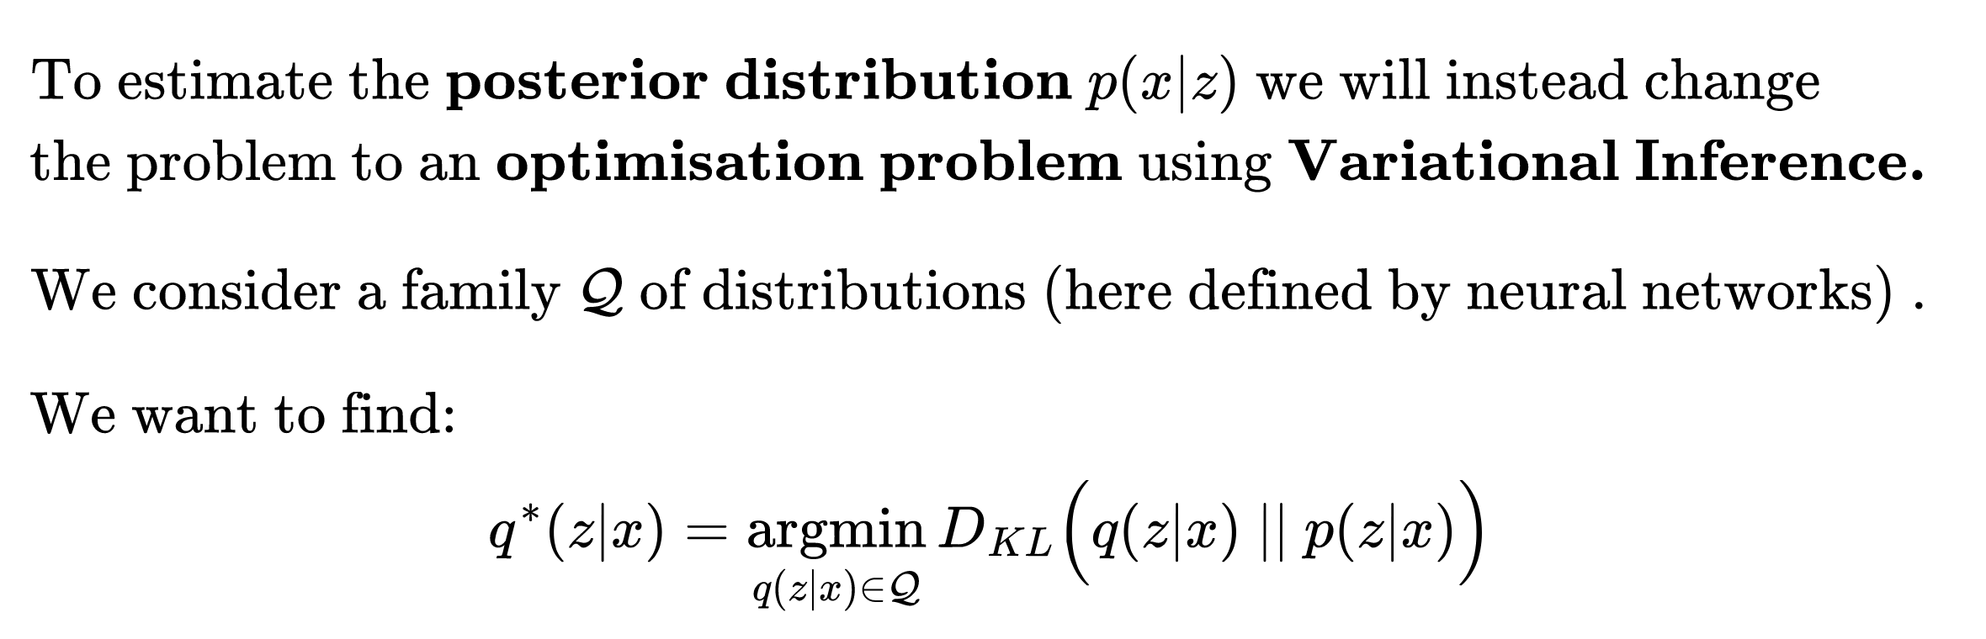
Variational Bayesian Learning
19

Slide 20
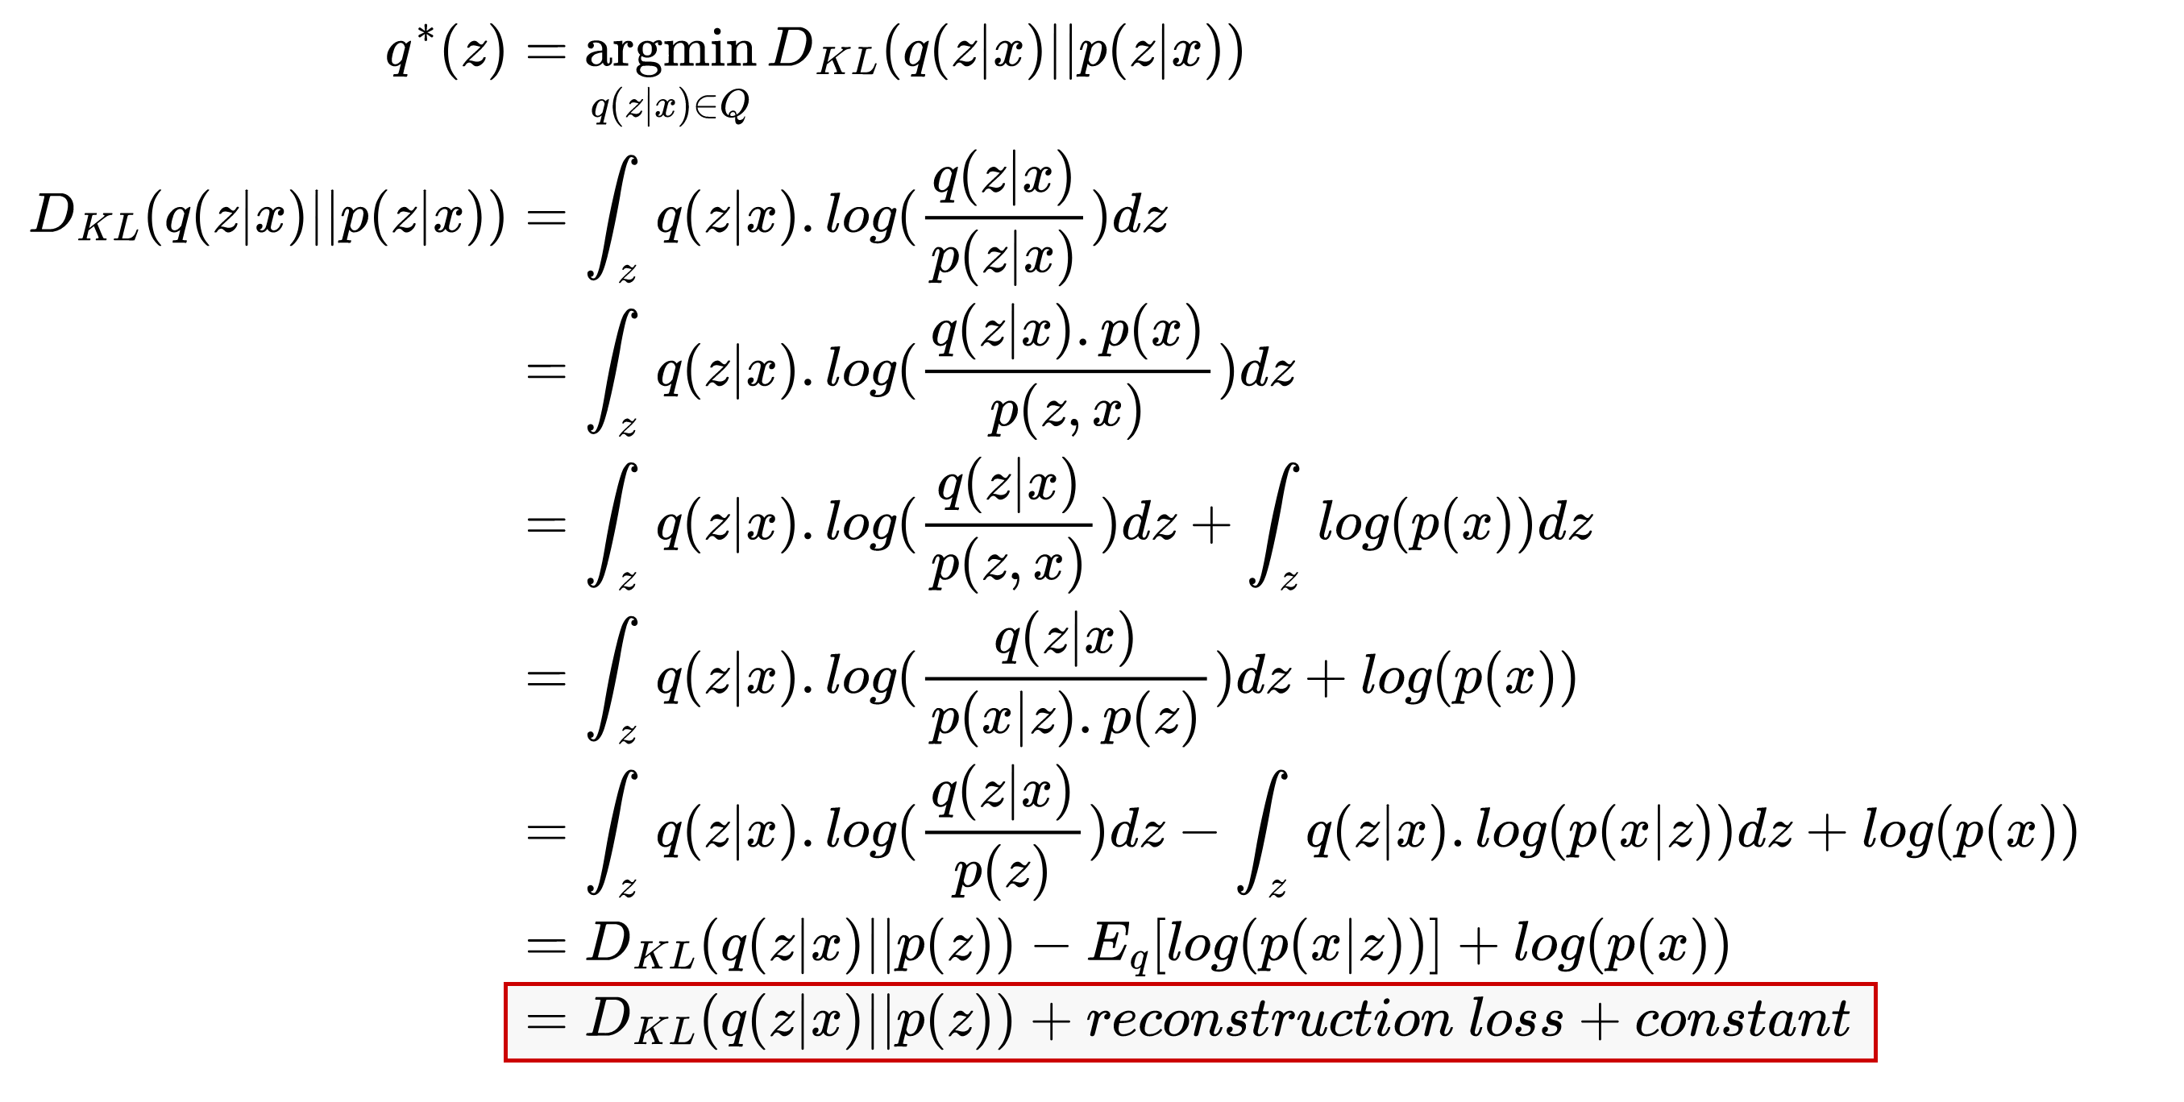
Variational Bayesian Learning: ELBO
20

Slide 21
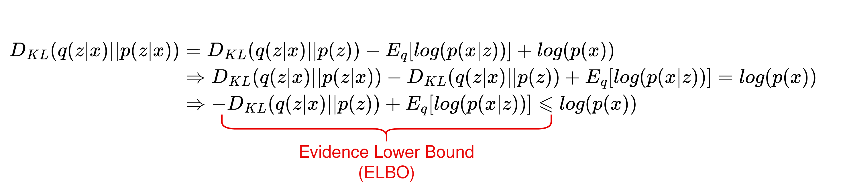
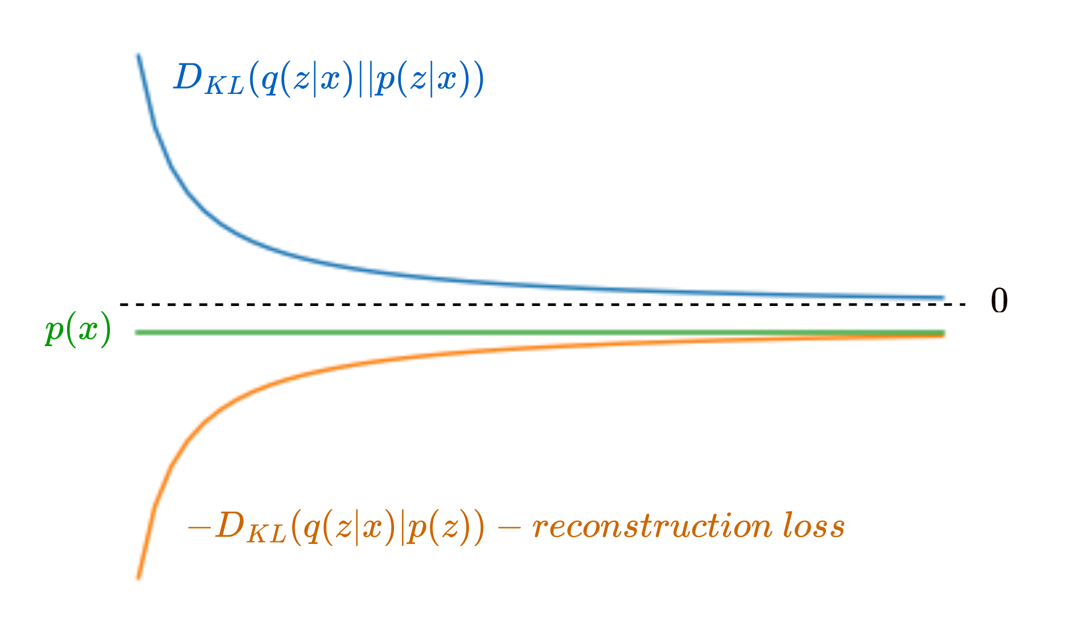
Variational Bayesian Learning: ELBO
In conclusion, minimising the DKL between our estimated posterior and the true posterior is equivalent to maximizing the ELBO
21

Slide 22
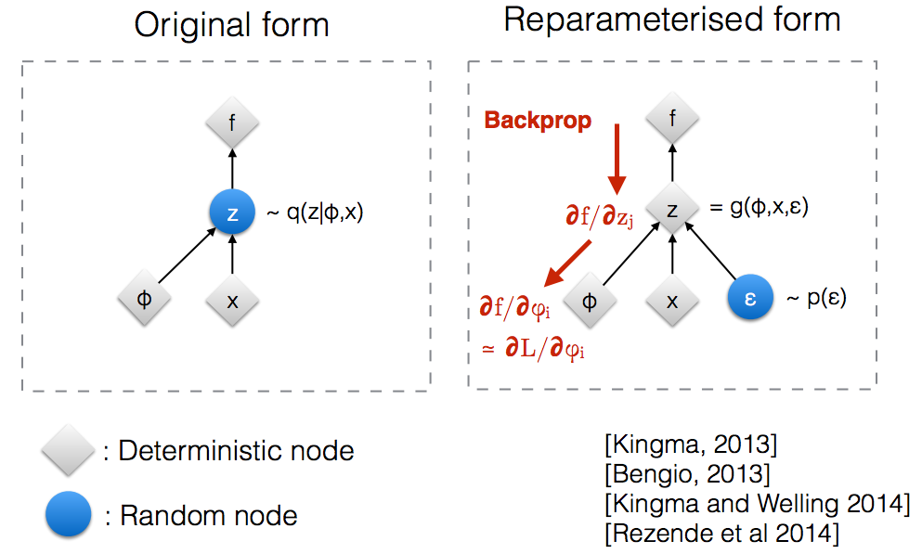
Reparametrization trick
22

Slide 23
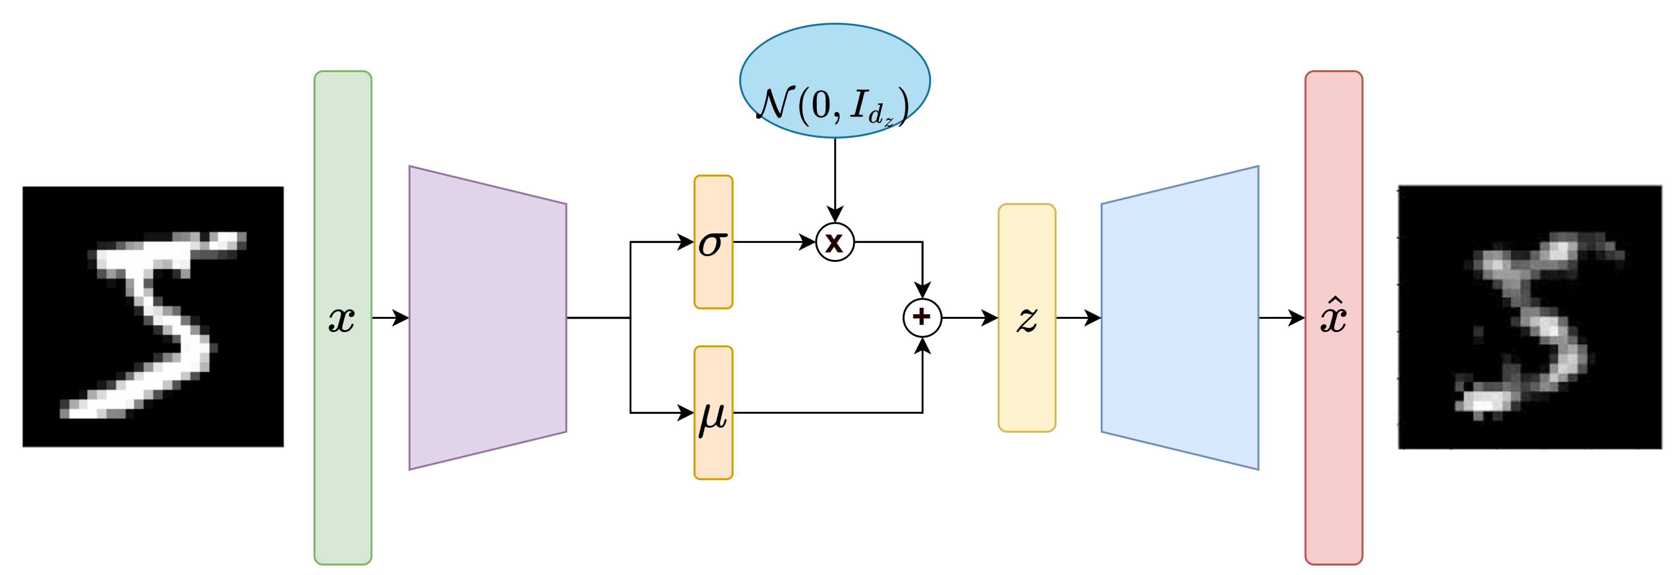
Variational Auto-Encoders
23

Slide 24
Quick break then coding session
24
Notes:
Objectif : Explorer le potentiel des méthodes de gen. Profondes pour remplacer quand la quantité de données le justifie, les méthodes classiques de modélisation
24

